Slide 1
Female representation on boards and CEO performanceinduced turnover: Evidence from Russia
PRESENTER：井沫涵 马川

Slide 2


Motivation
Theory&Hypotheses
Methodology & Data
Main Results & Findings
Discussion & Implications
Conclusion
CONTENTS

Slide 3

Motivation

Slide 4
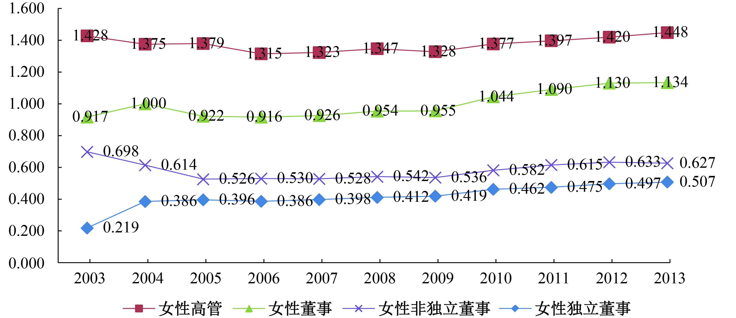
BACKGROUND
The artical investigate the association between female representation on boards and chief executive officerperformance-induced turnover as well as subsequent firm value in Russian firms.
2015 2016 2017 2018 2019 2020 2021 2022 2023 2024 2025
Although improving female board representation has been globally advocated as consistent with best corporate governance practices , recent reviews of the literature show that the average correlation between female board representation and firm performance is small and not statistically significant.

Slide 5
研究背景
BACKGROUND
Why choose Russia?
History of patriarchy
Gender disparity
Regulatory advocacy for women on boards is nonexistent in Russia.Because there is no gender quota, the effect of women on boards is untainted by quota-induced bias. In other words, female board representation in Russia occurs by happenstance rather than a regulatory outcome.
Russian culture regards women as patronesses and supporters of the societal units with which they affiliate, such as families . Women are perceived as being more empathetic, collaborative, and supportive than Russian males , qualities that are also prevalent among women in top positions such as board directors.

Slide 6
研究背景
BACKGROUND
Significant contributions made through research
4.Identified factors to reduce CEO
turnover performance sensitivity
1.Clarified the impact of female board representatives
Performance-related CEO turnover declines with CEO tenure.Trust may arise in boards that are patient and supportive of their CEO.
We find that reduced CEO turnover–performance sensitivity in firms with female boards is associated with greater board activities and an increase in firm value.
3.Explain the effectiveness of
the board of directors
2.Focus on CEO turnover
Our findings suggest that board qualities such as patience, collaboration, perseverance, and diligence help enhance firm value. Our results identify economic benefits associated with board activities that aim to facilitate better monitoring and advising of a board.
Boards are primarily charged with management oversight rather than direct responsibility for corporate financial outcomes. Our findings extend the current knowledge on how women in the boardroom affect corporate outcomes that are directly subject to the board.

Slide 7
研究背景
BACKGROUND
Research questions
Will female board members affect CEO performance sensitivity?
Will female board members affect company value?
Will female board members enhance company value by increasing board activities after retaining underperforming CEOs?
The study also contributes to the
burgeoning research on corporate governance in emerging economies. Although the Russian economy has demonstrated unprecedented growth among emerging markets , research on corporate governance in Russia is slim. Our study is among the first efforts to address this issue, and our findings extend current understandings of how female boards perform in a patriarchal country.

Slide 8

Theory &
Hypotheses

Slide 9

研究背景
Theory
Both control and collaboration approaches are proposed in the corporate governance literature, corresponding to the dual role of corporate boards in monitoring and advising.
Collaboration
On the one hand, researchers have argued that, to be effective, boards must acquire strategic information from management, especially in exercising their advising function
Control
On the other hand, maintaining an arm's-length relationship to top managers and acting quickly to replace a CEO in response to poor performanc
e are considered effective mechanisms for effecti
ve board monitoring

Slide 10
研究背景
Theory
Intense board monitoring can effectively discipline managerial behavior.However, intensive board monitoring can be costly.
Friendship between CEOs and their directors can jeopardize board independence
Agency costs arise when boards monitor in a loose manner
Too much board monitoring blocks
A board that is overpowered by its CEO will make decisions in favor of the CEO at the expense of shareholders
Such as poor financial reporting quality, excess CEO compensation , and corporate fraud
Effective communications between CEOs and their directors . Boards short of strategic information are less effective

Slide 11

研究背景
Hypotheses
We expect a female board in Russia to grant its CEO additional time to improve performance when suffering from performance hardship. The reason is twofold.
02
The patience and supportive
ness of female directors suggest that the board will not choose to rely on firm performance as much to ascertain the CEO's effort. Instead, “soft”information such as perceived quality of a CEO will be referred to when deciding whether to fire the CEO, in cases of poor performance. As a result, the sensitivity of firm performance and CEO turnover declines.
01
Russian women on boards share the fundamental qualities of the female population in this country in being empathetic and supportive. Boards with greater female representation will show sympathy and grant their CEOs more time to fix the problem. They are also willing to spend time investigating whether poor performance is due to the CEO's action or to bad luck.
The researchers formally state their hypothesis as follows.

Slide 12
Hypotheses
Hypothesis 1. CEO turnover–performance sensitivity decreases with an increase in female representation on boards.
Female board representation adds value to a firm in terms of CEO turnover decisions.
The problem of using current performance to infer the CEO's efforts to create long-term value effects
Reduced CEO turnover - performance sensitivity
Relieve
Allow
According to implicit contract theory, this evaluation approach will improve firm value, as there is an economic value to rewarding CEOs for performance that will manifest in the future but is not currently public knowledge
The board of directors conducts a more comprehensive evaluation of the CEO's performance

Slide 13
Hypotheses
Hypothesis 2. CEO retention decisions made by female boards after poor performance are associated with improved firm value in the future.
The second hypothesis is not without tension. Female boards can decrease firm value by lowering CEOs' incentives to work hard because their representation may indicate weak monitoring. That is, CEOs may already know that they will be retained regardless of their performance outcomes (Fama, 1980; Jensen, 1986), a decision that will be detrimental to firm value.

Slide 14

Methodology
&Data

Slide 15
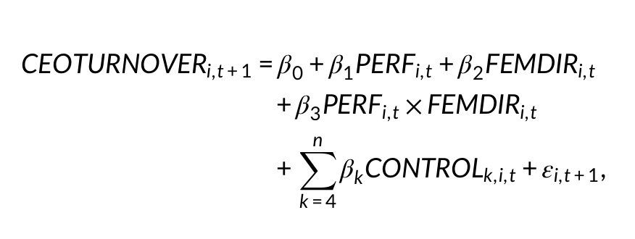
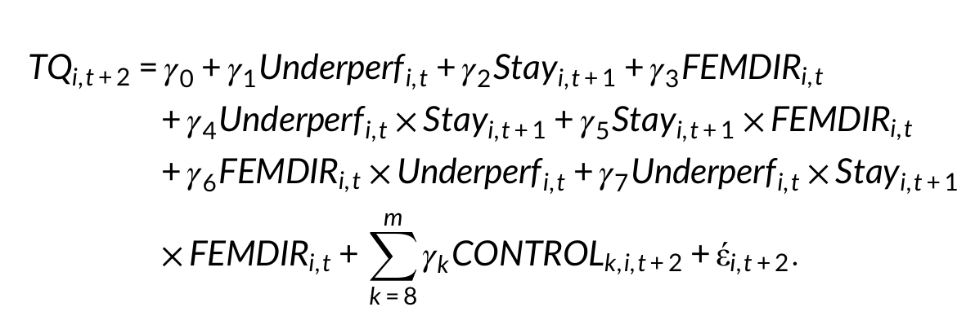
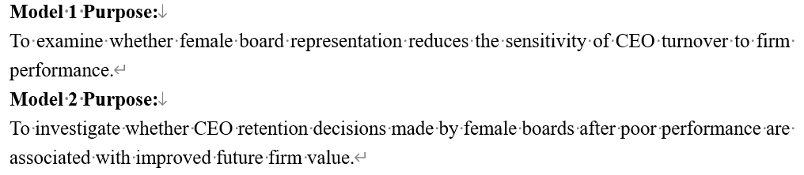
Methodology & Data
Research sample: Companies in the S&P 1500 index, covering multiple years
Data Source
Key variable definitions
Model
ExecuComp: Get CEO compensation and resignation data.
BoardEx (or ISS): Get data on board members’ background, gender, tenure, etc.
Compustat: Get company financial data.
Dependent Var: Performance-induced Turnover - usually defined as a dummy variable (0 or 1) to identify involuntary turnover through news analysis or specific algorithms.
Independent Var: Female Representation - e.g., whether there are women on the board (0/1), percentage of female directors (%).
Performance Measure: Industry-Adjusted Stock Return or Return on Assets (ROA).
Use Logit or Probit regression models to test hypotheses

Slide 16
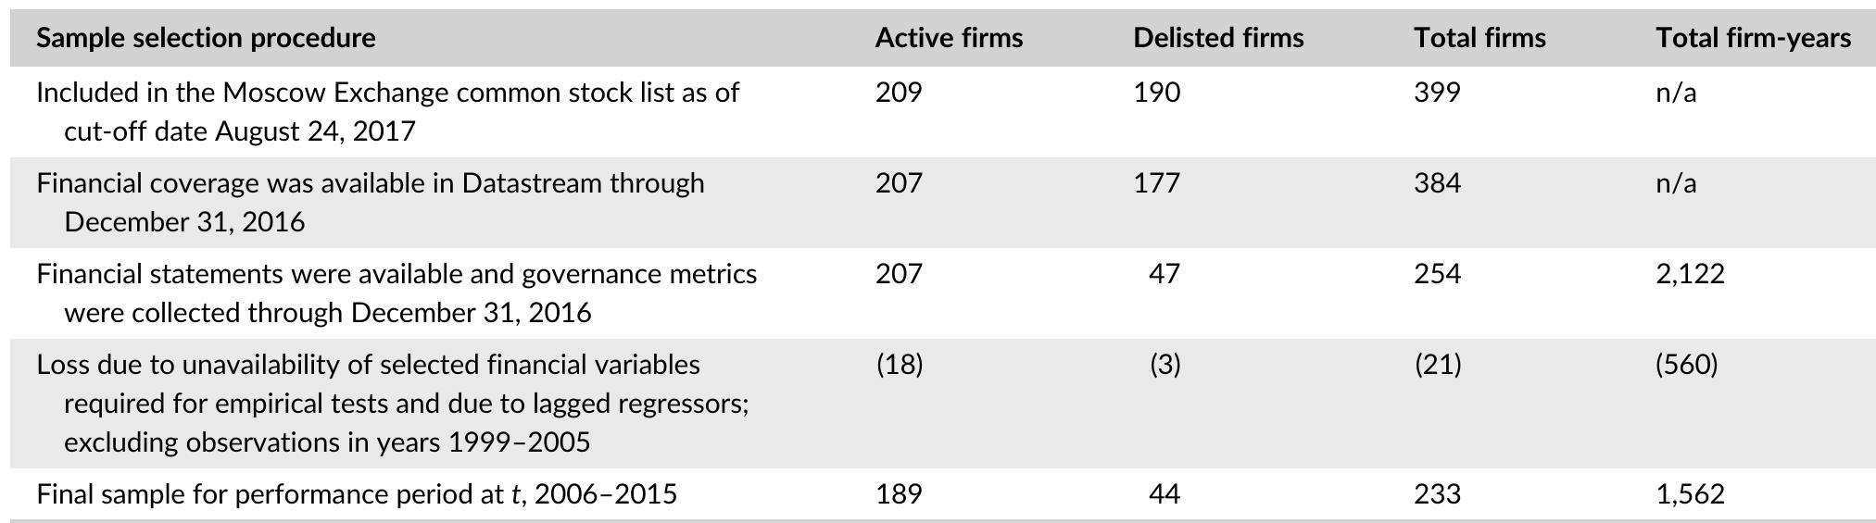
Methodology & Data
To examine whether female directors enhance the effectiveness of board functioning, we focus on joint tests of Hypotheses 1 and 2. Specifically, we first examine whether female boards are associated with reduced CEO turnover–performance sensitivity. Then, we test whether a CEO retention decision made by female boards can predict enhanced firm value in the following year.
The table reports the summary of the data collection process for the performance period t. Firms included in the sample are those listed on the RTS and MICEX prior to the merger in 2011 and those listed on the joint Moscow Exchange post-merger.

Slide 17
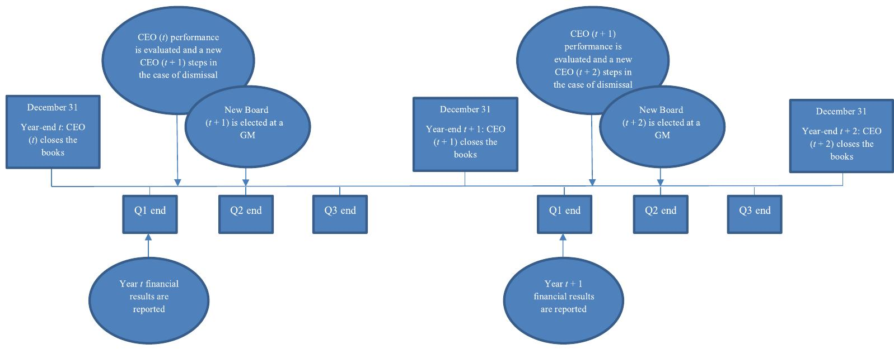
Methodology & Data
We use a set of measures for female representation, including an indicator variable for the presence of at least one female director on the board (0/1FemDir), the number of female directors (#FemDir), and the proportion of female directors on the board (%FemDir) at the end of year t. A significantly positive coefficient of PERF × FEMDIR
(β3) will be consistent with Hypothesis 1, that female boards are less likely to replace their CEO when firm performance is poor.

Slide 18
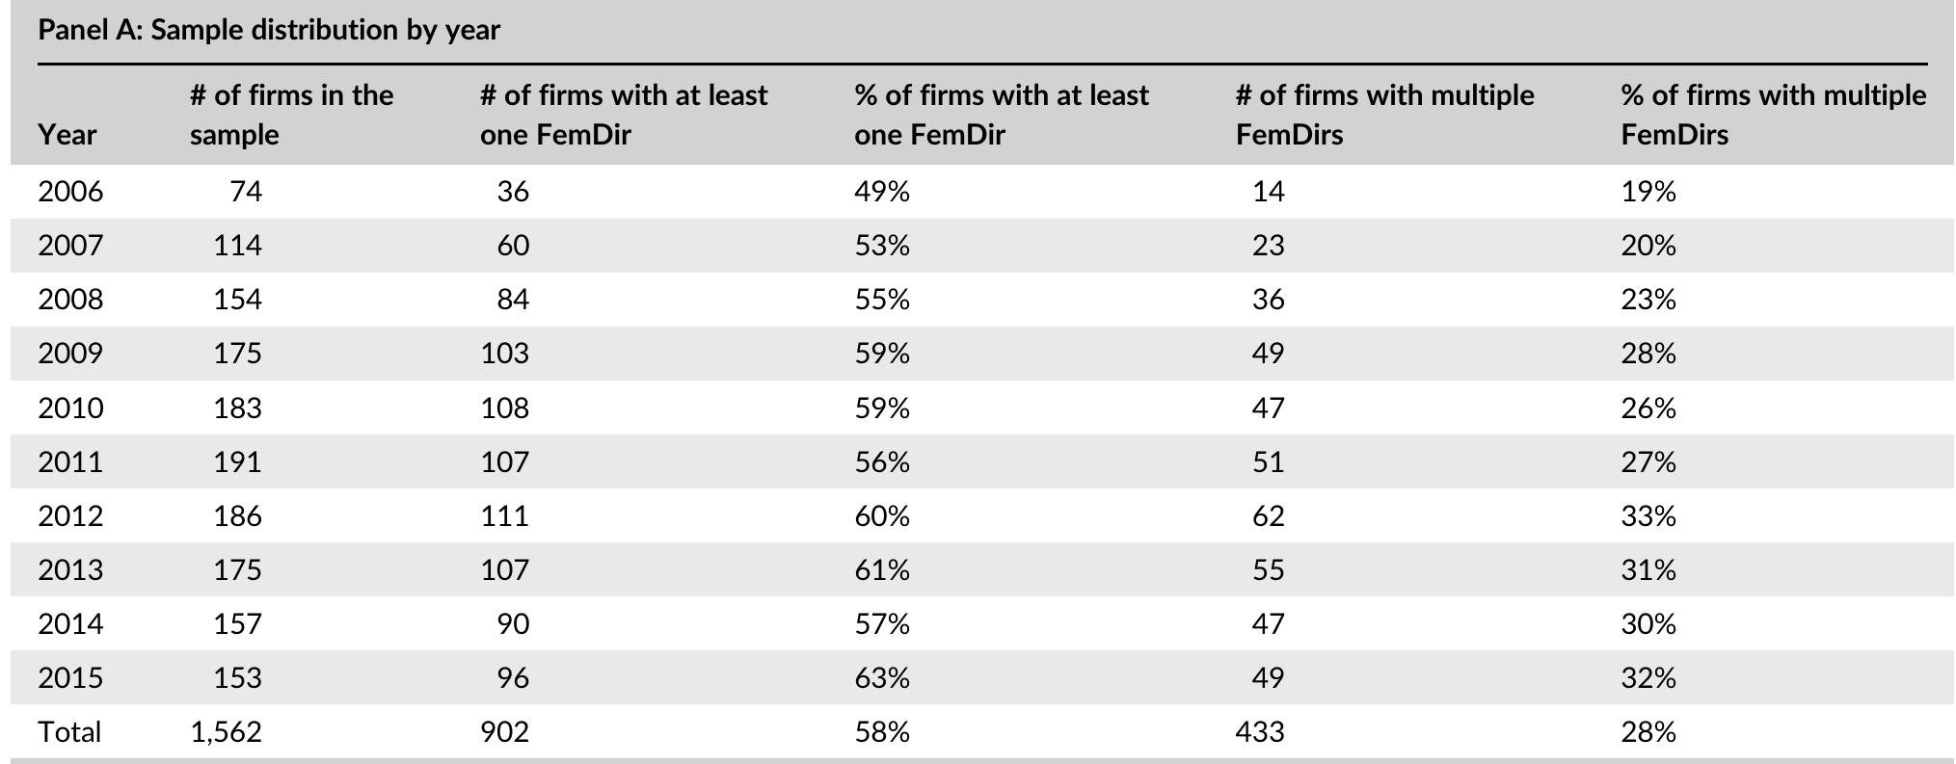
Methodology & Data
Panel A of Table 2 reports the sample distribution by year, which is consistent with prior work . On average, 58% (28) of firm-years had at least one (more than one) female director on the board.Although we observe an uptrend in women on boards over time, female board representation in Russia is still lower than that in the United States and European nations.

Slide 19

Main Results
& Findings

Slide 20
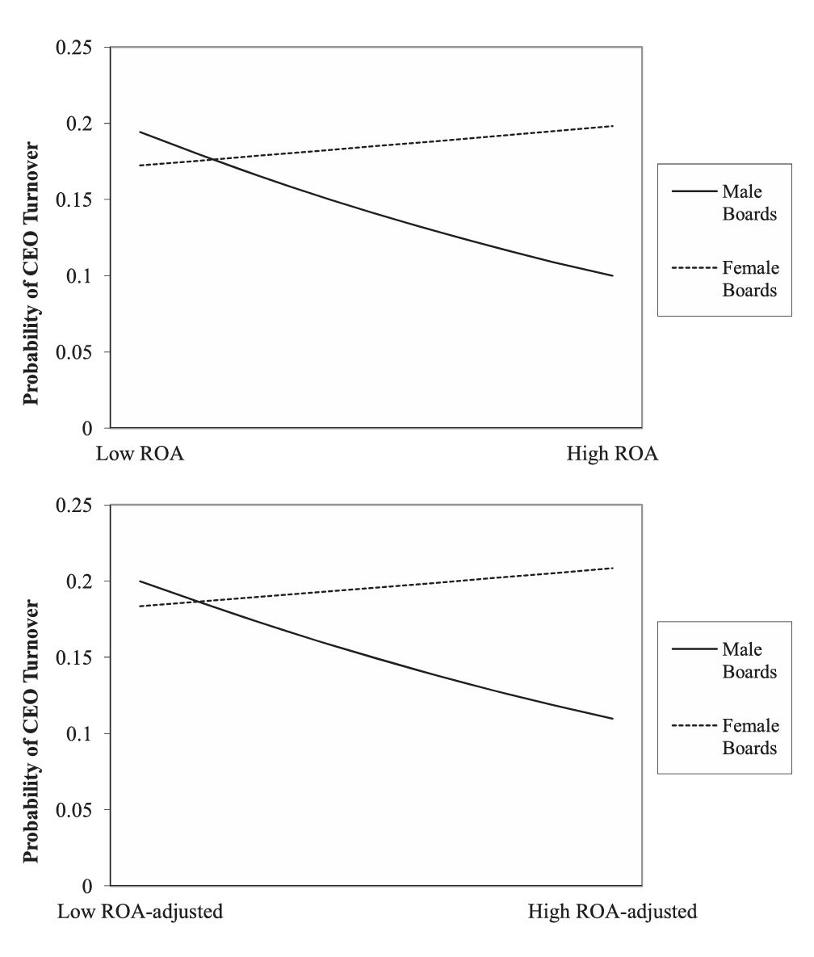
Main Results & Findings
Key findings : Female boards are holding CEOs accountable for their performance
The worse a company's performance, the more likely it is that a board with female directors will fire its CEO
Discovery One :
Enhanced Monitoring
Discovery Two :
Influence Effect
The negative correlation between poor corporate performance and CEO turnover is significantly stronger in boards with female directors.
This oversight effect is even more pronounced when there is more than one female director or serves on key committees (e.g., audit, nomination).
Discovery Three : Enhanced Monitoring
When there are no female directors: Even at the bottom of the performance, the probability of CEO turnover only increased slightly from 5% to 7%. When there are female directors: The probability of CEO leaving the lowest-performing companies soars to 18%, nearly three times as high.

Slide 21
Robustness Checks
Multi-dimensional and multi-method verification of the consistency of core findings
01 Alternative Measures
02 Addressing Endogeneity
Core question: Do female directors bring better supervision, or do companies with good governance tend to appoint women?
Solution:
Instrumental variable method (IV): Find an external variable that only affects the appointment of female directors and does not directly affect the departure of CEOs.
Propensity score matching (PSM): Pair and compare companies with female directors with companies that are very similar in all aspects but do not have female directors.
Test results: After considering endogeneity, the conclusion remains robust.
Test 1 (Replace PI): Use "Return on Assets (ROA)" instead of "Equity Returns" with the same conclusion.
Test 2 (Change of Definition of Turnover): Applying a stricter definition of "passive CEO turnover", the conclusions remain significant.
03 Additional Tests
Test 1 (sample adjustment): Excluding the financial crisis years/specific industries, the conclusion remains unchanged.
Test 2 (model setting): Using different regression models (such as linear probability model), the conclusions are highly consistent.
Conclusion Passed all stress tests and has high reliability

Slide 22

Discussion &
Implications

Slide 23
Discussion & Implications
From research to practice: The business value of board diversity
For Companies & Boards
Promoting gender diversity on boards of directors is a strategic investment to protect shareholder interests, improve internal oversight, and reduce agency costs, rather than just meeting compliance requirements.
The addition of female directors is not a "vase" or tokenism, but a catalyst for improving the effectiveness of corporate governance.
For Investors & Analysts
When assessing a company’s governance (the “G” in ESG), the gender composition of the board of directors and its representation on key committees should be considered as an effective and quantifiable risk assessment indicator.
For Policymakers
Policies promoting (or mandating) more women on boards can boost capital market accountability and efficiency.

Slide 24

Conclusion

Slide 25
CONCLUSION
The artical further test the economic consequences of the decisions made by female boards to retain an underperforming CEO.
Researchers find that women on boards are associated with lower CEO turnover–performance sensitivity.
The results also suggest that female boards create firm value, as CEO retention decisions by female boards are associated with more board activities and higher Tobin's Q in the following year.
Taken together, results suggest that female boards are not only patient and supportive but also good monitors. These results should be of interest to both academics and regulators, as we offer a very different view of female representation on boards than prior studies.

Slide 26
CONCLUSION
The interpretation of our findings is, however, subject to several caveats.
“There is no such thing as a random allocation [of treatment assignment]” using observational data.The choice to appoint female directors may relate to various factors that could drive our results.
Researchers rely on a Heckman selection correction procedure to mitigate selection on unobservables. However, the efficacy of their approach is still open to debate.
Their findings are potentially subject to representation issues as female directors might possess characteristics different from the female population in Russian society.
Nevertheless, the research questions they ask are generalizable, as it is equally important to investigate in AngloSaxon settings whether certain board qualities could enhance shareholder value. The artical call for future research to add knowledge to this area.

Slide 27
Thanks for listening
PRESENTER：井沫涵 马川

